Slide 1
MIT
TEAMWORK PROPOSAL
By 孙启傲 陆伊炀 徐启城
2024.4.17

Slide 2
MIT
TEAMWORK PROPOSAL
Music-Image Transfer
By 孙启傲 陆伊炀 徐启城
2024.4.17

Slide 3
CONTENTS
01
02
Purpose
Challenge
03
04
Plan
Resource

Slide 4
Purpose
01

Slide 5

Purpose
Input
(A piece of) music
Prompt (optional)
Output
“The music commenced with the enchanting melody of a captivating female voice...”
Image according to audio and prompt
Description of the audio
Ex.
burn.mp3
“A little girl standing in the middle of night, dressed in red... ”
From Phigros

Slide 6

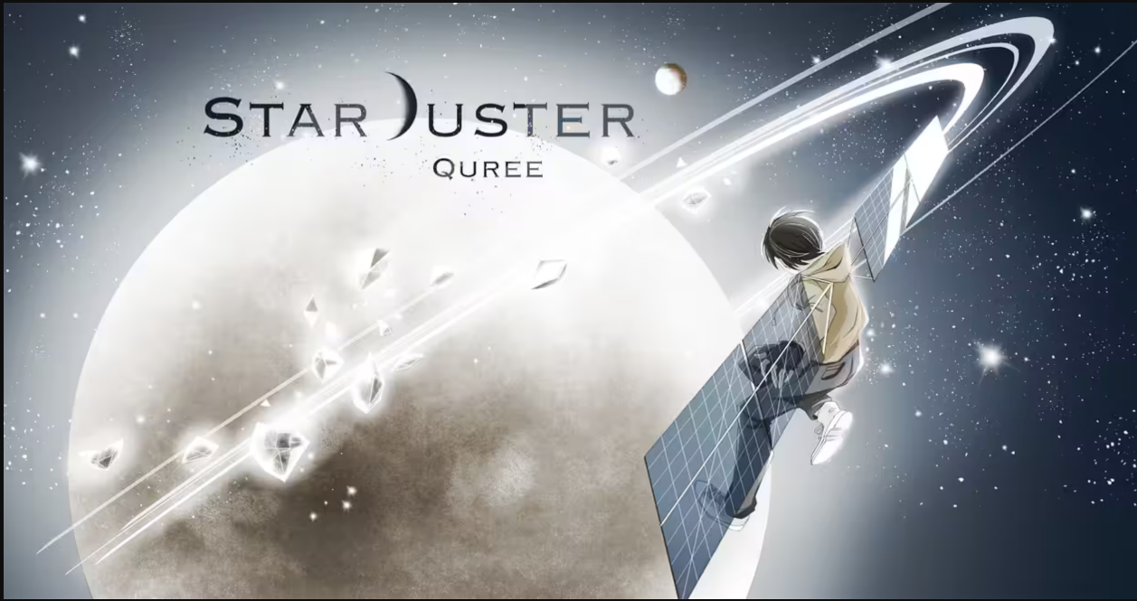
Purpose
What can it do
Generate illustrations for music video games
Create song album covers
Generate concert posters
Who will benefit
Illustrators
Music creators

Slide 7
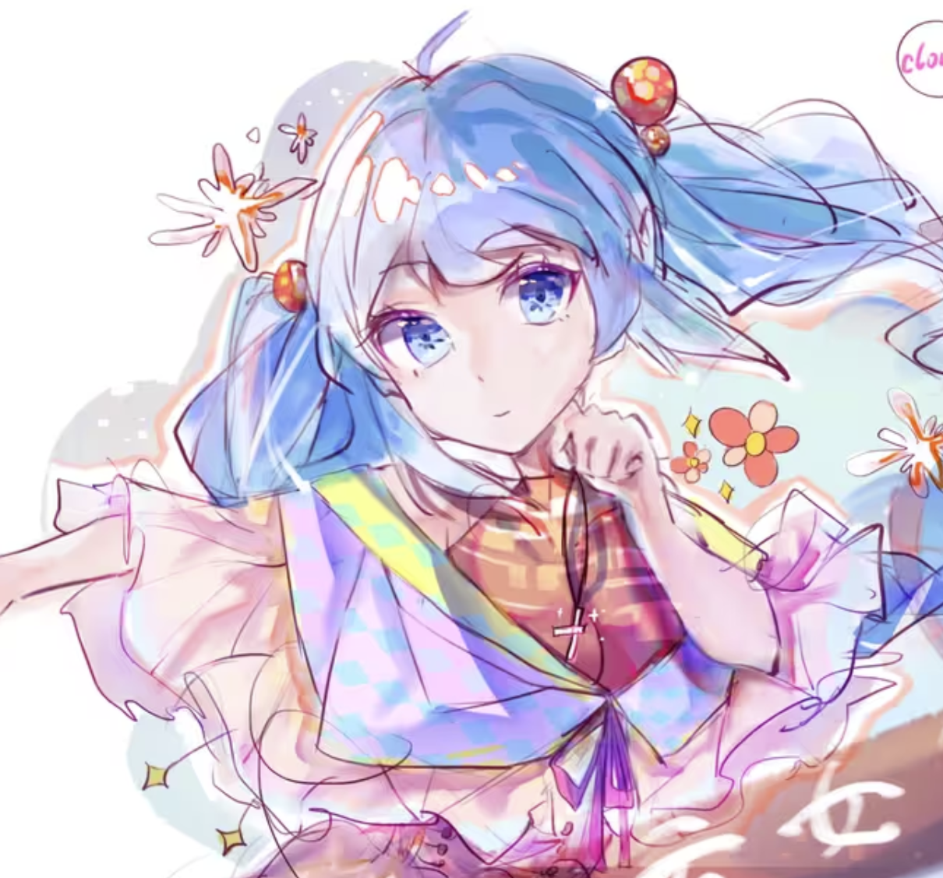
Purpose
Text to Music LLM
(ex. suno.ai)
What can it do
You
description
Generate illustrations for music video games
Create song album covers
Generate concert posters
description
music
Who will benefit
Illustrators
Music creators
Maybe … Everyone!
Our
MIT
Your own album!

Slide 8
Challenge
02

Slide 9

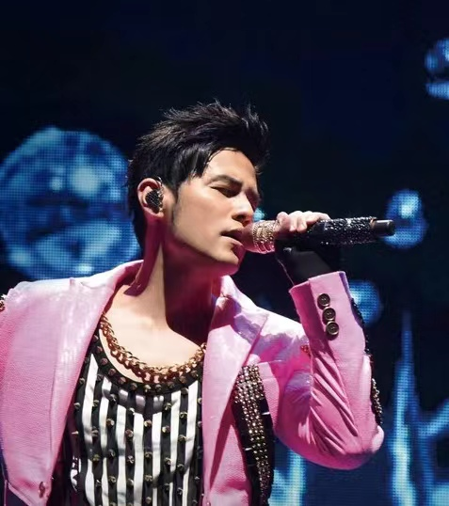
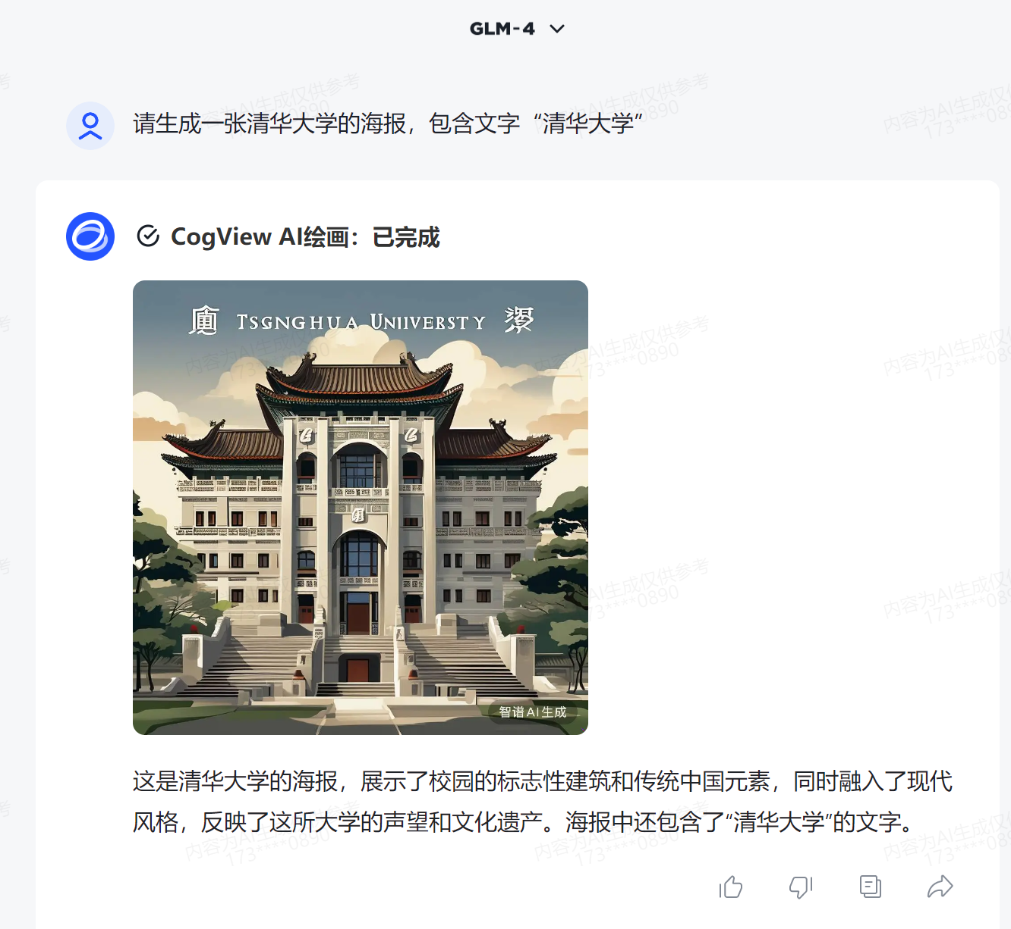
Challenge
Pure music to text
Hard to retrieve information from pure music
Lack of labeled data
Train with data if no pretrained models
Recognize lyrics
Recognizing lyrics harder than words in speech
Add text to image
LLM unknown about writing on image

Slide 10
Plan
03

Slide 11
Lyrics : Pick proper model and add to prompt
Label&Info : Retrieve info from background music with designed tools, or use NN
Text : When needed, separate text with the image generated and add the text externally
Plan

Slide 12
Resource
04

Slide 13

Resources
12 nvidia 4090 : To train model on
5 million tokens : Used to detail the user prompt.
Vpn : Download models & dataset
Data: Music with emotion label, both with and without lyrics
Last but not least : less homework / simpler exam on intro2sys

Slide 14
THANKS

Slide 15
Challenge
Pure music to text
Hard to retrieve information from pure music
Lack of labeled data
Train with data if no pretrained models
Recognize lyrics
Recognizing lyrics is harder than words in speech
Add text to image
LLM doesn’t know how to write on image

Slide 16
Challenges
Pure music to text
Hard to retrieve information from pure music
Lack of labeled data
Train with data if no pretrained models
Recognize lyrics
Recognizing lyrics is harder than words in a speech
Add text to image
LLM doesn’t know how to write on image

Slide 17

添加标题

Slide 18

单击此处添加大标题内容

Slide 19

标题
单击此处添加正文，文字是您思想的提炼，为了演示发布的良好效果，请言简意赅的阐述您的观点。

Slide 20
添加标题
单击此处添加正文，文字是您思想的提炼，为了演示发布的良好效果，请言简意赅的阐述您的观点。您的内容已经简明扼要，字字珠玑，但信息却千丝万缕、错综复杂，需要用更多的文字来表述。

Slide 21


Slide 22

单击此处添加正文，文字是您思想的提炼，为了演示发布的良好效果，请言简意赅的阐述您的观点。您的内容已经简明扼要，字字珠玑，但信息却千丝万缕、错综复杂，需要用更多的文字来表述；但请您尽可能提炼思想的精髓。

Slide 23


Industry Background
产业背景概述
据市场分析，行业分析，敏感性和财务分析，我们将在创业的第一个财政年度达到收支平衡，并争取从六个财政年度争取在大陆或香港上市当我们的公司不具备上市条件或因为其它原因不能上市时，我们将利用寻求机会与国外同行合作，实现部分股权让购，投资者的股票同样具有很好的流动我们将在有必要的时候进行企业资本的回购，通过收益及银行贷款等手段，逐步回购公司股票，直至投资方最终退出，也为投资者们提供另一种退出渠道

Slide 24

Industry Background
产业背景概述
据市场分析，行业分析，敏感性和财务分析，我们将在创业的第一个财政年度达到收支平衡，并争取从六个财政年度争取在大陆或香港上市当我们的公司不具备上市条件或因为其它原因不能上市时，我们将利用寻求机会与国外同行合作，实现部分股权让购。

Slide 25
THANKS.

